Slide 1

Introductory Computer Networking and IT Security
Week 12

Slide 2
Agenda
Risk Management (Assessing Risks, Treating Risks)
CBA
Planning for contingencies

Slide 3
Introductions to IT risk management
Information security departments are created primarily to manage IT risk
Managing risk is one of the key responsibilities of every manager within the organization
In any well-developed risk management program, two formal processes are at work:
  Risk Identification and Assessment
  Risk Control

Slide 4
Introductions to IT risk management
Knowing Ourselves
  Identifying, examining, and understanding the information and how it is processed, stored, and transmitted.
  Armed with this knowledge, initiate an in-depth risk management program.
  Risk management is a process of creating the safeguards and controls which are not installed-and-forgot.
  Risk management is devised and implemented in your organization.

Slide 5
Introductions to IT risk management
Knowing the Enemy
  Identifying, examining, and understanding the threats facing the organization’s information assets
  Managers must be prepared to fully identify those threats that pose risks to the organization and the security of its information assets.
  Risk management is the process of assessing the risks to an organization’s information assets and determining how those risks can be controlled or mitigated.

Slide 6
Risk Identification
  Risk identification begins with the process of self-examination.
  Managers identify the organization’s information assets, classify them into useful groups, and prioritize them by their overall importance.

Slide 7
Creating an Inventory of Information Assets
  Identify information assets, including people, procedures, data and information, software, hardware, and networking elements.
  This step should be done without pre-judging the value of each asset.
  Asset values will be assigned later in the process.

Slide 8
Classifying and Categorizing Assets
  Once the initial inventory is assembled, determine whether its asset categories are meaningful.
  Inventory should also reflect sensitivity and security priority assigned to each information asset.
  A classification scheme categorizes these information assets based on their sensitivity and security needs.
  Each of these categories designates the level of protection needed for a particular information asset.
  Some asset types, such as personnel, may require an alternative classification scheme that would identify the clearance needed to use the asset type.
  Classification categories must be comprehensive and mutually exclusive.

Slide 9
Assessing Values for Information Assets
  As each information asset is identified, categorized, and classified, assign a relative value.
  Relative values are comparative judgments made to ensure that the most valuable information assets are given the highest priority, for example:
    Which information asset is the most critical to the success of the organization?
    Which information asset generates the most revenue?
    Which information asset generates the highest profitability?
    Which information asset is the most expensive to replace?
    Which information asset is the most expensive to protect?

Slide 10
Listing Assets in Order of Importance
  The final step in the risk identification process is to list the assets in order of importance.
  This goal can be achieved by using a weighted factor analysis worksheet.

Slide 11
Threat Identification
  Any organization typically faces a wide variety of threats.
  If you assume that every threat can and will attack every information asset, then the project scope becomes too complex.
  To make the process less cumbersome, each step in the threat identification and vulnerability identification process is managed separately and then coordinated at the end.
  .

Slide 12
Identify and Prioritize Threats and Threat Agents
  Each threat presents an unique challenge to information security and must be handled with specific controls that directly address the particular threat and the threat agent’s attack strategy.
  Before threats can be assessed in the risk identification process, however, each threat must be further examined to determine its potential to affect the targeted information asset .
  In general, this process is referred to as a threat assessment.
  .

Slide 13
Vulnerability Assessment
  Once you have identified the information assets of the organization and documented some threat assessment criteria, you can begin to review every information asset for each threat.
  This review leads to the creation of a list of vulnerabilities that remain potential risks to the organization.
  Vulnerabilities are specific avenues that threat agents can exploit to attack an information asset.
  At the end of the risk identification process, a list of assets and their vulnerabilities has been developed.
  This list serves as the starting point for the next step in the risk management process: risk assessment.
  .

Slide 14
Risk
  Risk is the likelihood of the occurrence of a vulnerability multiplied by the value of the information asset minus the percentage of risk mitigated by current controls plus the uncertainty of current knowledge of the vulnerability.
  Asset A has a value of 50 and one vulnerability, which has a likelihood of 1.0 with no current controls. Your assumptions and data are 90% accurate.
    Vulnerability 1 rated as 55 = (50 . 1.0) – 0% + 10%

Slide 15
Risk Control Strategies
Avoidance
Transference
Mitigation
Acceptance

Slide 16
Avoidance
  Avoidance is the risk control strategy that attempts to prevent the exploitation of the vulnerability.
  Avoidance is accomplished through:
    Application of policy
    Application of training and education
    Countering threats
    Implementation of technical security controls and safeguards

Slide 17
Transference
  Transference is the control approach that attempts to shift the risk to other assets, other processes, or other organizations.
  This may be accomplished by rethinking how services are offered, revising deployment models, outsourcing to other organizations, purchasing insurance, or by implementing service contracts with providers.

Slide 18
Mitigation
  Mitigation is the control approach that attempts to reduce, by means of planning and preparation, the damage caused by the exploitation of vulnerability.
  This approach includes three types of plans:
    Incident Response Plan (IRP)
    Disaster Recovery Plan (DRP)
    Business Continuity Plan (BCP)
  Mitigation depends upon the ability to detect and respond to an attack as quickly as possible.

Slide 19
Acceptance
  The choice to do nothing to protect an information asset and to accept the loss when it occurs
  This control, or lack of control, assumes that it may be a prudent business decision to examine the alternatives and conclude that the cost of protecting an asset does not justify the security expenditure.

Slide 20
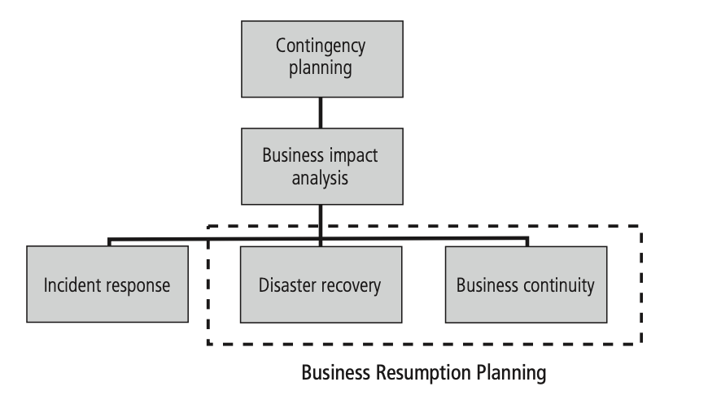
Continuity Strategies
The IR (Incident Response)plan focuses on immediate response, but if the attack escalates or is disastrous (e.g., fire, flood, earthquake, or total blackout), the process moves on to the DR plan and BC plan.
The DR (Disaster Recovery)plan typically focuses on restoring systems at the original site after disasters occur, and it is therefore closely associated with the BC plan.
The BC (Business Continuity) plan occurs concurrently with the DR plan when the damage is major or long term, requiring more than simple restoration of information and information resources. The BC plan establishes critical business functions at an alternate site.

Slide 21
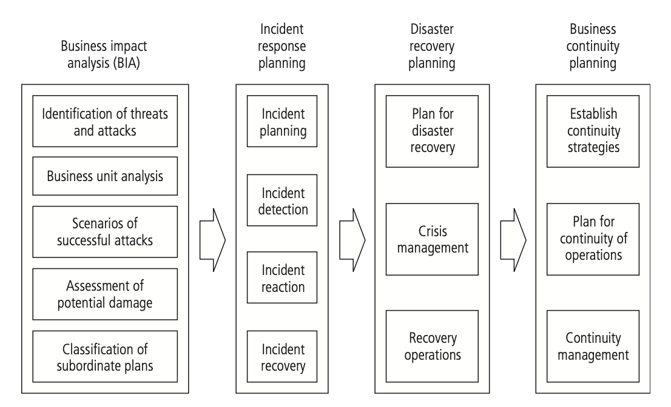
Major Steps in Contingency Planning

Slide 22
Cost Benefit Analysis
  The criterion most commonly used when evaluating a project that implements information security controls and safeguards is Economic Feasibility.
  Organizations are urged to begin a cost benefit analysis by evaluating the worth of the information assets to be protected and the loss in value if those information assets are compromised.
  This decision-making process is called a Cost Benefit Analysis/Economic Feasibility Study.

Slide 23
Cost Benefit Analysis
Cost
  Just as it is difficult to determine the value of information, it is difficult to determine the cost of safeguarding it.
  Some of the items that affect the cost of a control or safeguard include:
  Cost of development or acquisition of hardware, software, and services
    Training fees
    Cost of implementation
    Service costs
    Cost of maintenance

Slide 24
Cost Benefit Analysis
Benefit
  Benefit is the value to the organization of using controls to prevent losses associated with a specific vulnerability.
  The benefit is usually determined by valuing the information asset exposed by the vulnerability and then determining how much of that value is at risk, i.e. how much risk there is for the asset.

Slide 25
Cost Benefit Analysis
Asset Valuation
  A Single Loss Expectancy (SLE), is the calculation of the value associated with the most likely loss from an attack.
  The SLE is a calculation based on the value of the asset and the expected percentage of loss that would occur from a particular attack:
    SLE = asset value (AV) x exposure factor (EF)
      Where EF = the percentage loss that would occur from a given vulnerability being exploited
  This information is usually estimated.

Slide 26
Cost Benefit Analysis
Asset Valuation
  In most cases, the probability of a threat occurring is the probability of loss from an attack within a given time frame.
  This value is commonly referred to as the Annualized Rate of Occurrence (ARO)
    ALE = SLE * ARO

Slide 27
Thank You

